Slide 1
DSD

Slide 2
Shannon’s Expansion theorem
According to Shannon’s expansion theorem
Any logic function f(w1,w2,w3,….,wn) can be expressed as
f(w1,w2,w3,….,wn)=w1 .f(0,w2,w3,…,wn)+ w1 . f(1,w2,w3,…,wn)
This can be done by taking any of the n variable

Slide 3
In Shannon’s expansion the term f (0, w2, . . . ,wn) is called the cofactor of f with respect to w1; it is denoted in shorthand notation as fw1 . Similarly, the term f (1, w2, . . . ,wn) is called the cofactor of f with respect to w1, written fw1 . Hence we can write
f = w1fw1 + w1fw1

Slide 4
In general, if the expansion is done with respect to variable wi , then fwi denotes
f (w1, . . . ,wi−1, 0, wi+1, . . . ,wn), fwi denotes f (w1, . . . ,wi−1, 1, wi+1, . . . ,wn), and
f (w1, . . . ,wn) = wifwi + wifwi

Slide 5
Shannon’s expansion can be done in terms of more than one variable. For example,
expanding a function in terms of w1 and w2 gives
f (w1, . . . ,wn) = w1w2 · f (0, 0, w3, . . . ,wn) + w1w2 · f (0, 1, w3, . . . ,wn)
+ w1w2 · f (1, 0, w3, . . . ,wn) + w1w2 · f (1, 1, w3, . . . ,wn)

Slide 6
So from the previous slides we can conclude that , any logic function can be implemented by using Shannon’s expansion theorem.

Slide 7

Ripple Carry Adder equation in terms of Generator and propagator functions

Slide 8
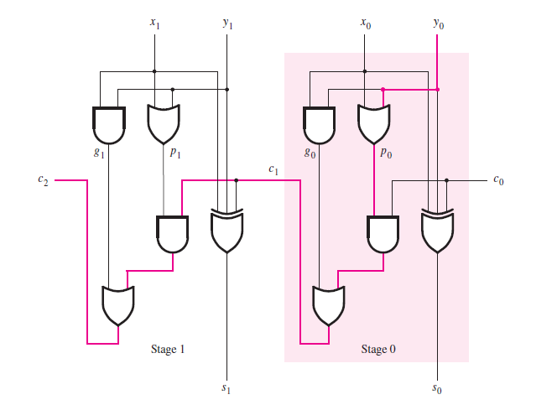
Ripple Carry adder

Slide 9

Fast Adders Equation in terms generator and propagator function considering i-1th stage

Slide 10
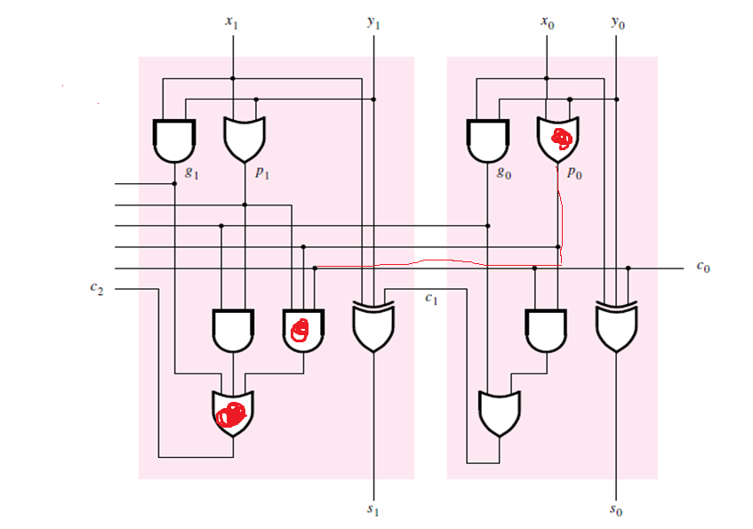
Fast Adders

Slide 11
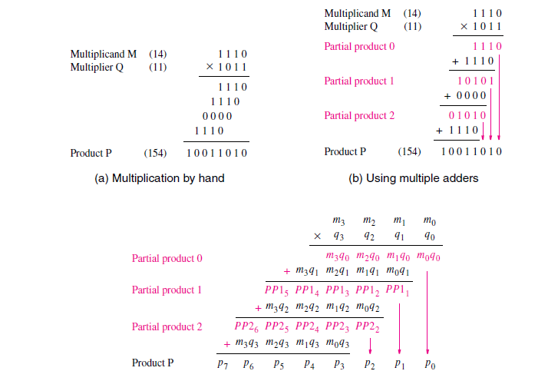

Slide 12
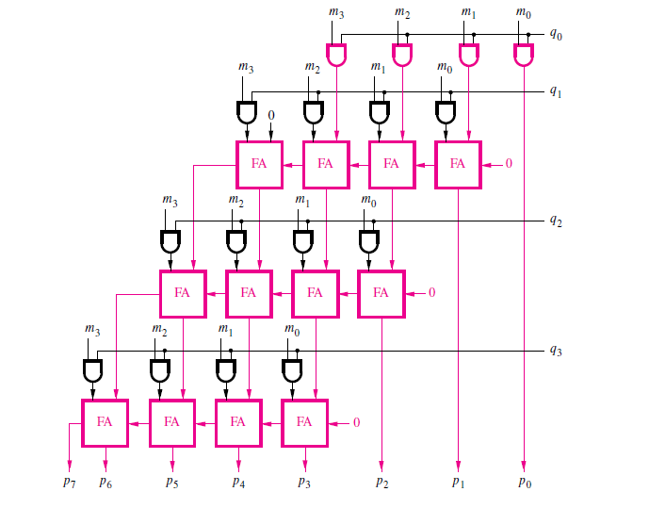

Slide 13
